Slide 1






Foundations of
Quantum Information Science (QIS 101)
Dave Biersach
Brookhaven National Laboratory
dbiersach@bnl.gov
Session 21
Digital Circuits

Slide 2
Session 21 – Goals
Understand Classical (Boolean) Digital Logic Circuits
Review base conversion (binary₂ ←→ decimal₁₀)
Analyze the three classical logic gates: NOT, AND, and OR
Learn how to chain multiple logic gates together in a circuit
Develop truth tables and calculate input & output states
Understand how half-adders and full-adders operate
Appreciate how memory and counters are constructed from gates
Simulate digital circuits using matrix algebra
Represent gates via their action operators
Combine multiple inputs using the tensor product of matrices

Slide 3

Base Conversion – Binary to Decimal
Position 6
Position 0
Most Significant Bit (MSB)
Least Significant Bit (LSB)
$$Weight={Base}^{Position}$$
1011001₂ = 89₁₀
← LSB
← MSB

Slide 4
Base Conversion – Decimal to Binary
Most Significant Bit (MSB)
Least Significant Bit (LSB)
% = Remainder (Mod)
// = Floor (Integer)
113₁₀ = 1110001₂
← LSB
← MSB

Slide 5
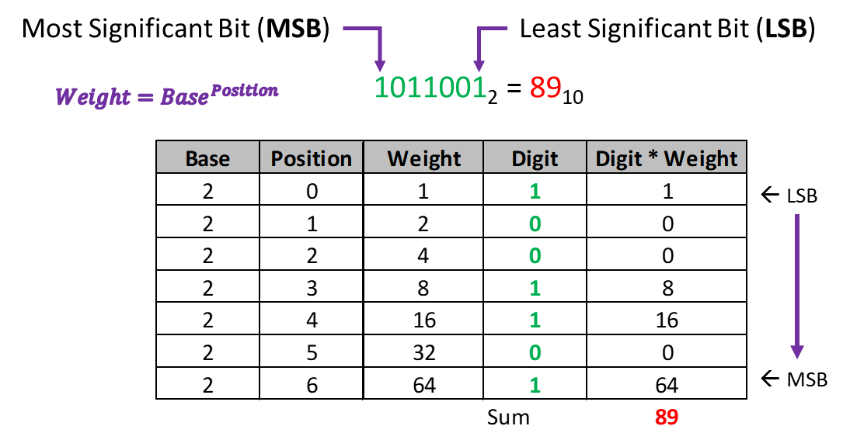
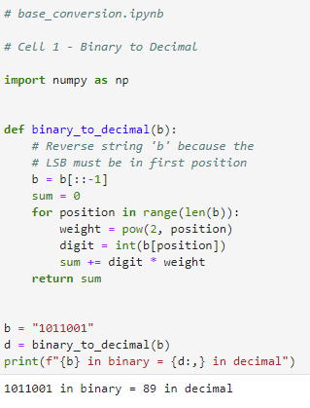
Run Cell 1 – base_conversion.ipynb
①
②
③
④
⑤
⑥
⑦

Slide 6
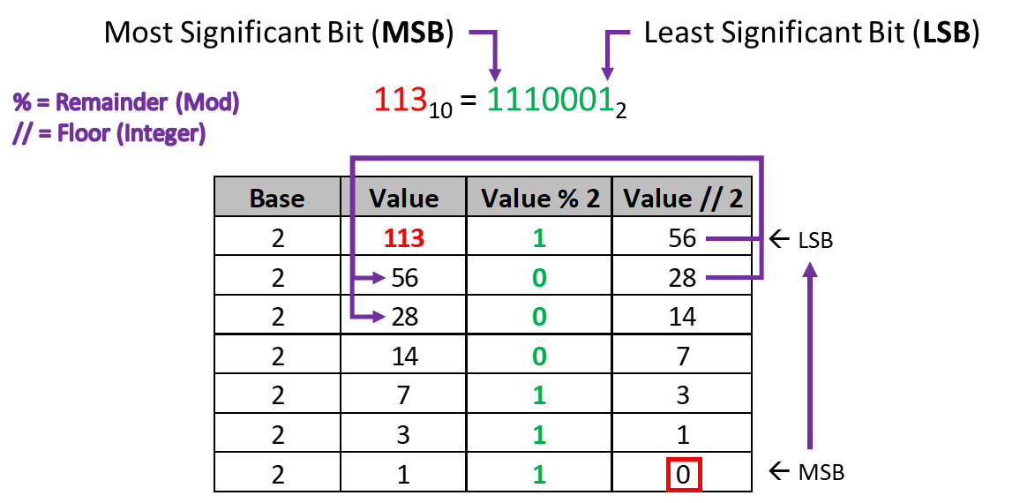
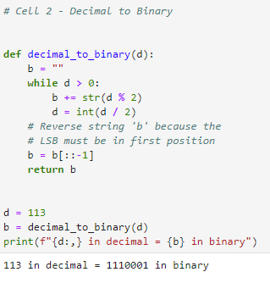
Run Cell 2 – base_conversion.ipynb
①
②
③
④
⑤
⑥

Slide 7
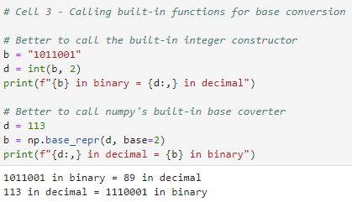
Run Cell 3 – base_conversion.ipynb
①
②
③
④
Knowing how to represent the decimal numbers 0 to 255 in binary (base 2) is very useful in quantum computing

Slide 8
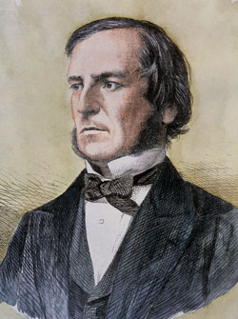
George Boole (1815 – 1864)
English mathematician
1847 published rules of symbolic logic (“Boolean Algebra”)
Only person with a data type named after him (“bool”)

Slide 9
Boolean Logic Gates
Logic Gates
Three types: NOT (inverter), AND, OR
Gates have 1 or 2 input lines, and 1 output line
Input / Output lines are either:
False, F, Cold, Low, L, 0 (Zero)
True, T, Hot, High, H, 1
The left side of a truth table is counted using Base 2 to ensure every possible permutation of input states is evaluated across the entire circuit

Slide 10
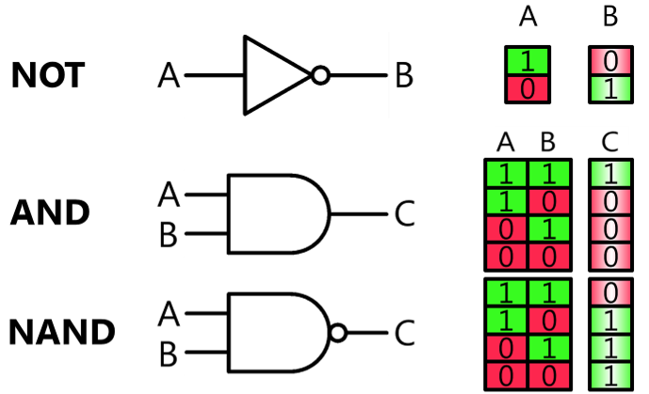
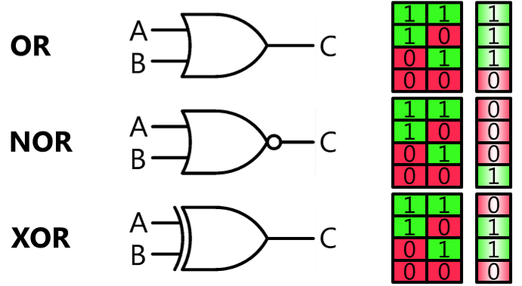
Boolean Logic Gates

Slide 11
Boolean Logic Gates
NOT (inversion) is sometimes shown as a “bar” on top
OR is a “sum” while AND is a “multiply” (modulo 2)
OR is sometimes shown as A + B
AND is sometimes shown as A • B
Circuits flow (propagate state) from “Left to Right”
The output of one gate flows into the input(s) of the next gate(s)
We can evaluate a gate’s output line only when we know the value for every input line entering that gate

Slide 12
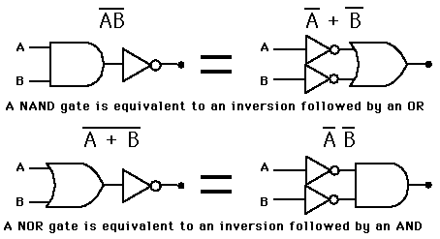
NAND and NOR Gates

Slide 13
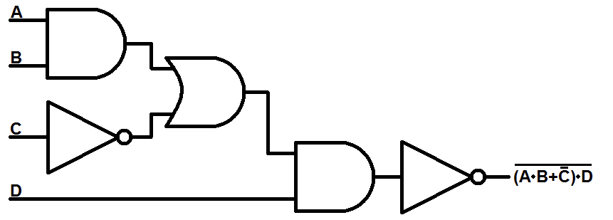
Chaining Logic Gates
AND
OR
NOT
AND
NOT

Slide 14
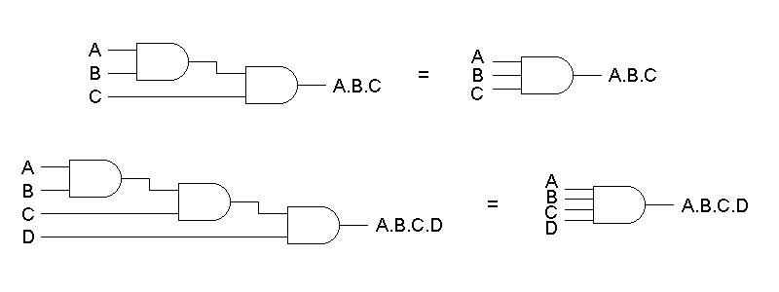
Multi-Input Gates

Slide 15
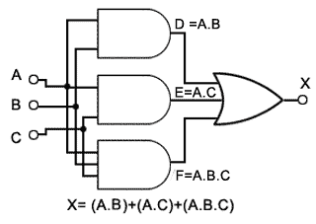
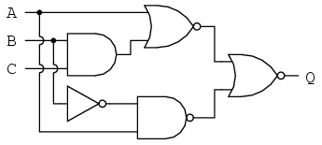
Wire Overlap vs. Intersection
Use filled circles only for electrical junction points
Carry forward current logic state of line into each branch

Slide 16
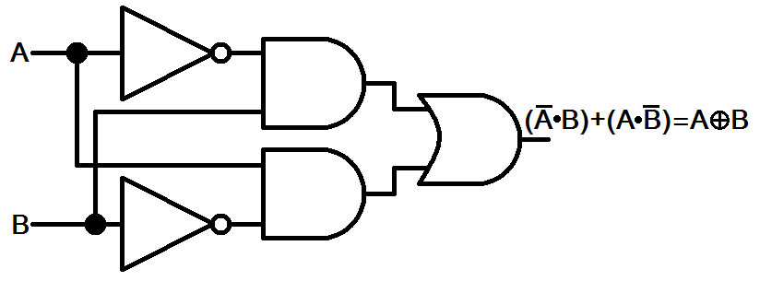
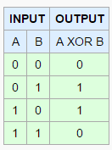
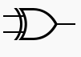
XOR Gate

Slide 17
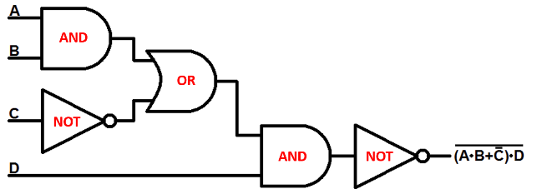
Truth Tables
1
1
1
1
1
0
1
0
1
0
0

Slide 18
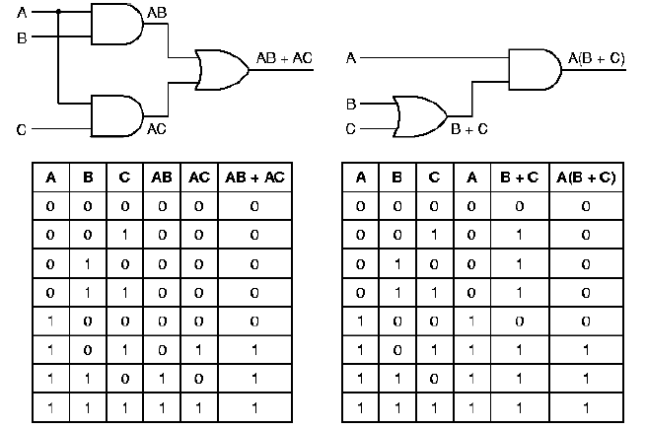
Truth Tables
$${000}_{2}=0_{10}$$
$${001}_{2}=1_{10}$$
$${010}_{2}=2_{10}$$
$${011}_{2}=3_{10}$$
$${100}_{2}=4_{10}$$
$${101}_{2}=5_{10}$$
$${110}_{2}=6_{10}$$
$${111}_{2}=7_{10}$$
With 3 input lines, there should be $2^{3}=8$ rows in the circuit’s truth table (0-7)

Slide 19
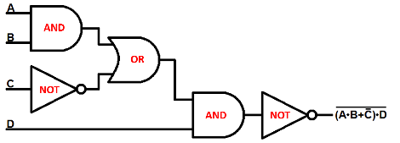

Simple Circuit
Complete this Truth Table
1
1
1
1
0
1
1
0
1
1

Slide 20
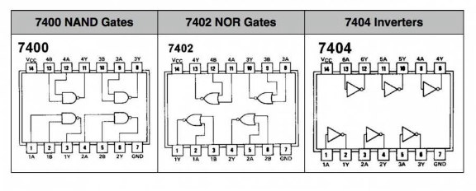
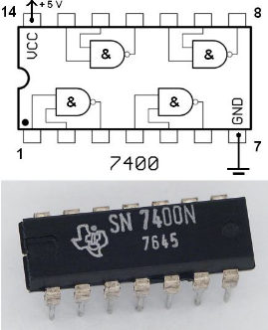
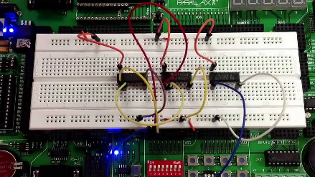
Logic Gates in the Real World

Slide 21
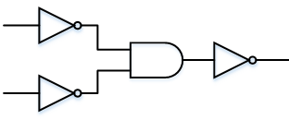
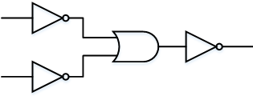
Gate Equivalence
Augustus De Morgan’s laws:
Can make an AND gate from 3 NOTs and 1 OR
Can make an OR gate from 3 NOTs and 1 AND
Simply invert both inputs and the output!
OR from AND
AND from OR

Slide 22
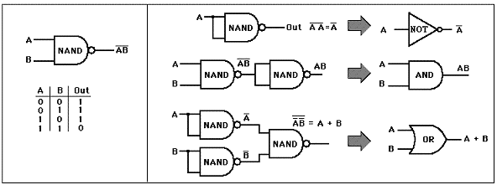
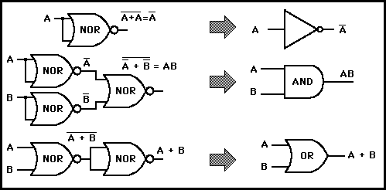
De Morgan’s Laws
We can build any circuit using just NAND or NOR gates!

Slide 23

Majority Vote Circuit
Create a truth table with input variables (A, B, C) that represent the vote (yeah or nay) of three people
Design a circuit that emits 1 as output if and only if at least 2 out of the 3 input lines are also 1
Start out by making a truth table for all 8 possible input permutations
Then use AND gates to select only those input permutations that that represent valid (1/high/true) “majority” output
Then use OR gates to gather the output of those AND gates into a single output line

Slide 24
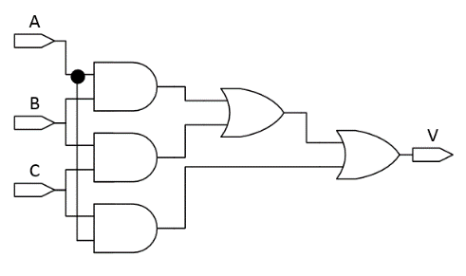
Majority Vote Circuit
1
0
0
0
0
1
1
1
1

Slide 25
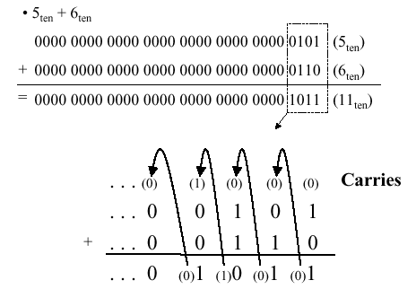
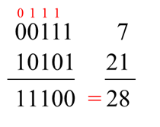
Binary Addition

Slide 26
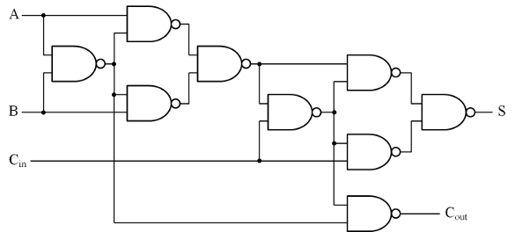
Full Adder Circuit using NAND gates

Slide 27
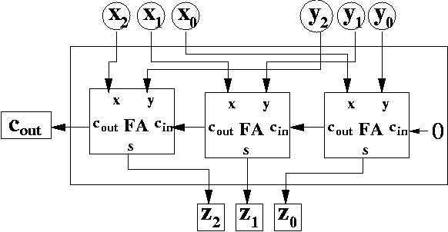
Chaining Full Adders with Ripple Carry
1 0 1 = 5
1 1 0 = 6
2
10
2
10
1
1
0
1
1
0
1
0
0
1
0
1
1
0 1 1
= 11
2
10

Slide 28
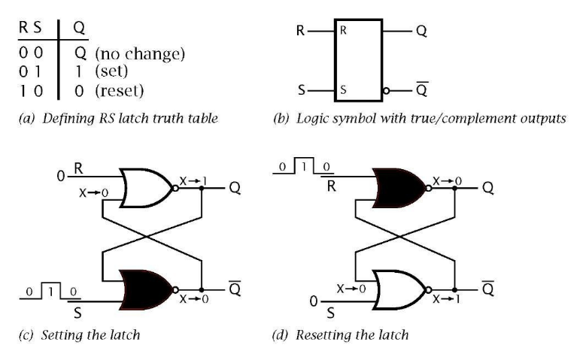
1 Bit Memory : Set-Reset Latch
The key was to send the output back into the input!

Slide 29
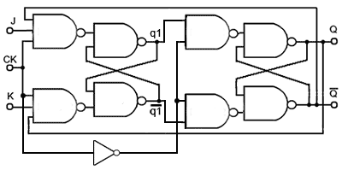
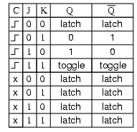
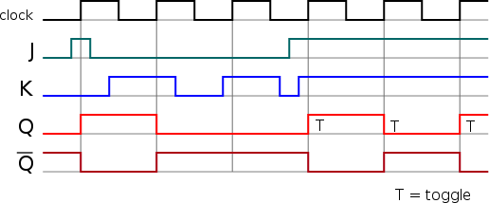
1 Bit Memory: A clocked J-K Flip-flop
A J-K flip-flop can be set/reset/toggled only during the rising edge of the clock signal
When the clock is low a latch maintains its prior output value

Slide 30
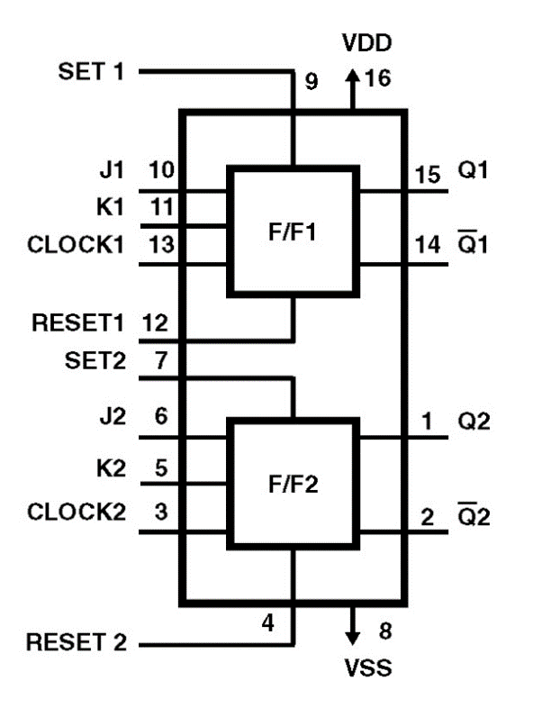
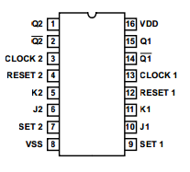
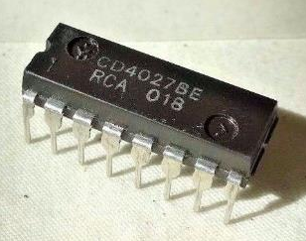
CD4027 Dual J-K Flip-Flop
+5V
CD4027BE
GND

Slide 31
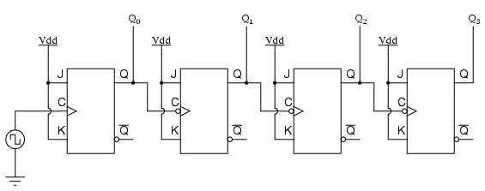
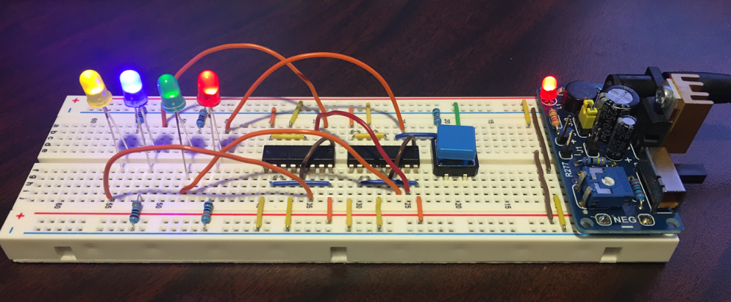
A 4-Bit Counter Using Clocked J-K Flip-Flops
+5V
+5V
+5V
+5V
LSB
MSB

Slide 32
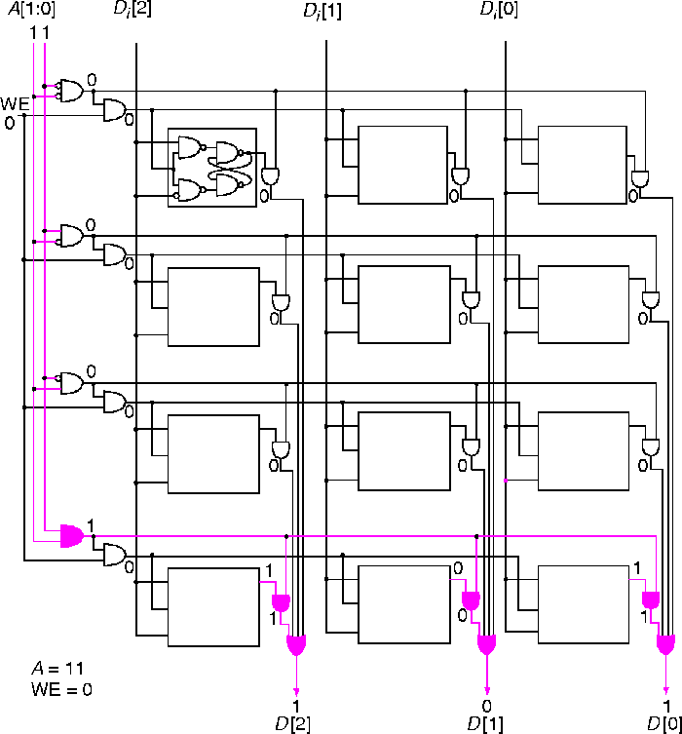
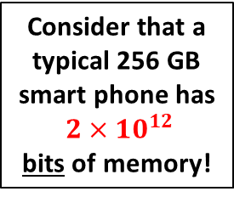
Reading 3 bits from a 4 address memory
Consider that a typical 256 GB
smart phone has
$2×{10}^{12}$
bits of memory!
Address Lines
This 12-bit memory
is made from a 4 x 3 matrix of flip-flops
Data Lines

Slide 33
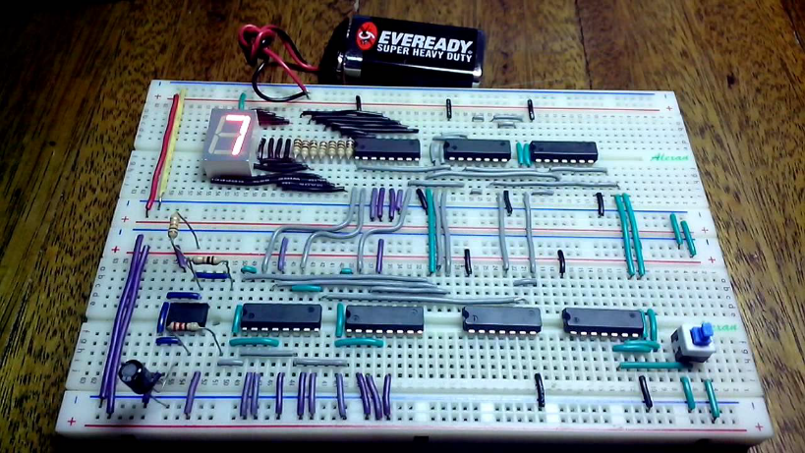
A Computer = An Adder with Memory

Slide 34
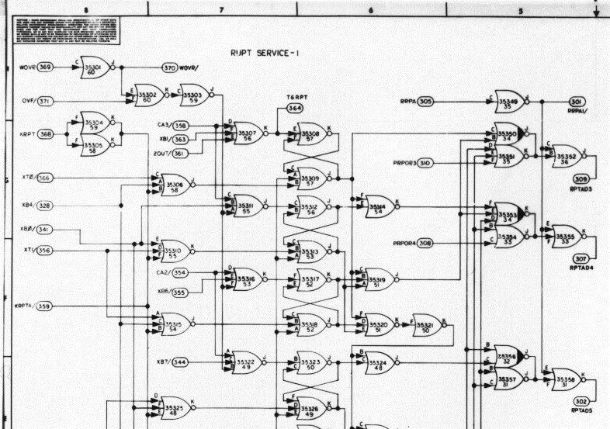
Apollo Guidance Computer

Slide 35
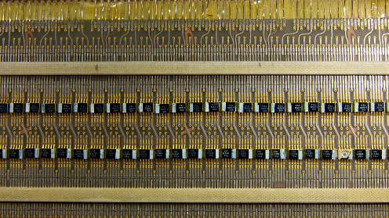
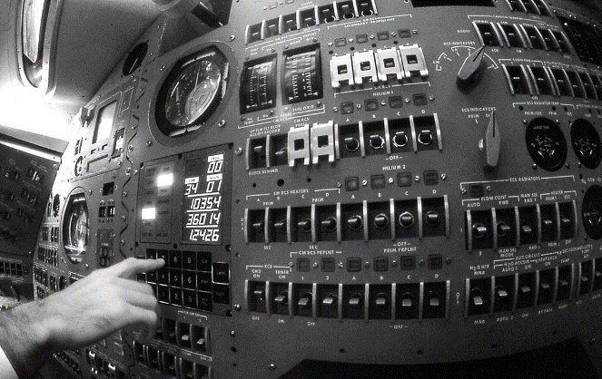
Apollo Guidance Computer

Slide 36
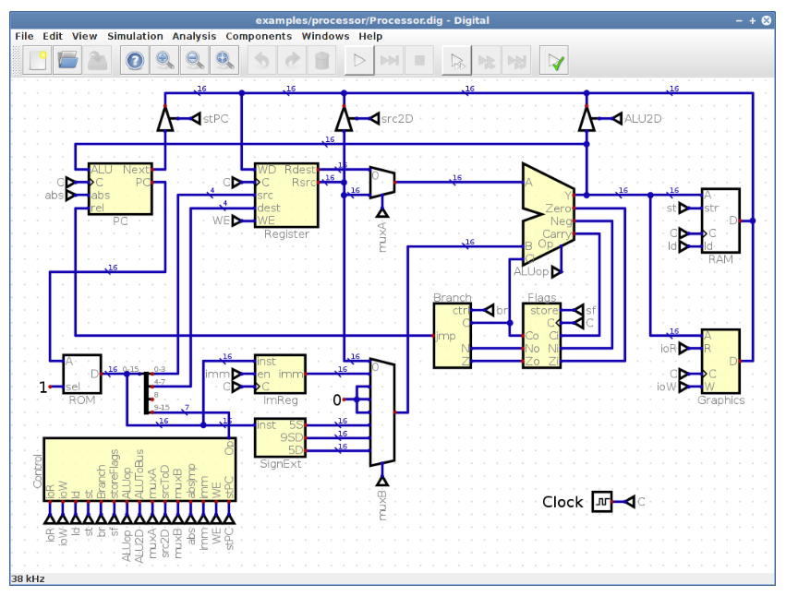
Digital Logical Simulator

Slide 37

Install Oracle Java Standard Edition
https://www.oracle.com/java/technologies/downloads

Slide 38
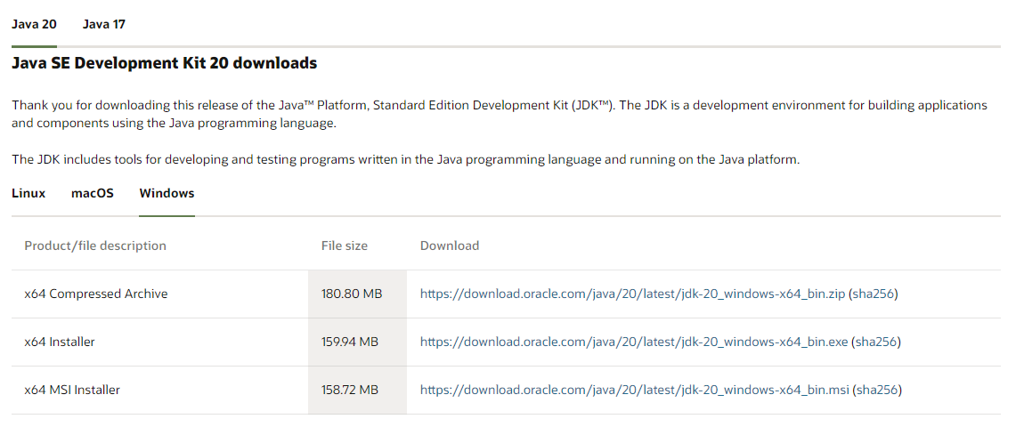
Oracle Java SE – Microsoft Windows
https://download.oracle.com/java/20/latest/jdk-20_windows-x64_bin.msi

Slide 39

Oracle Java SE – Apple macOS
https://www.oracle.com/java/technologies/downloads/#jdk20-mac

Slide 40
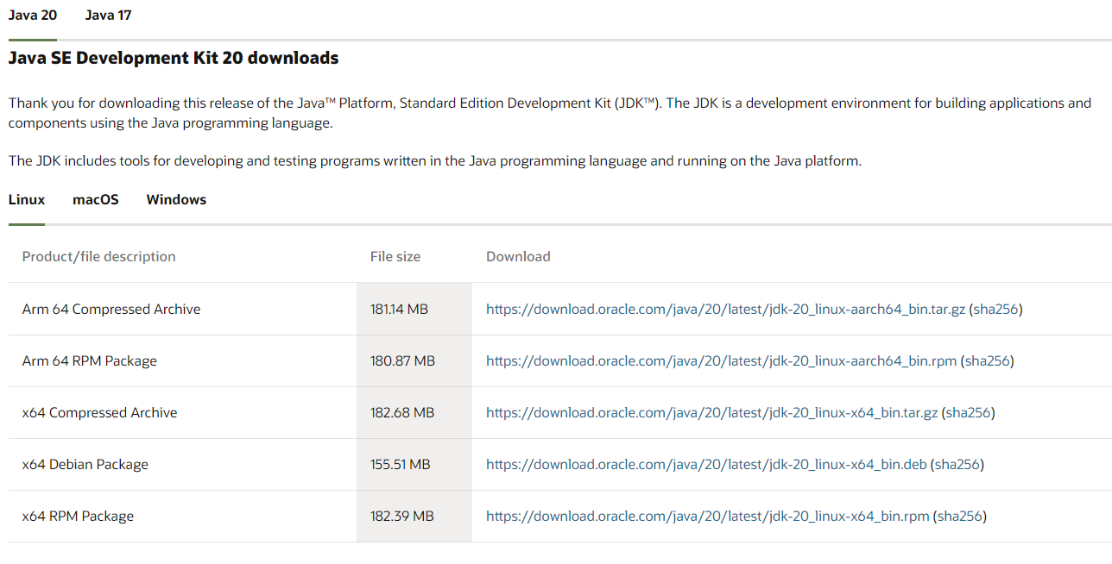
Oracle Java SE – Ubuntu Linux
https://www.oracle.com/java/technologies/downloads/#jdk20-linux

Slide 41
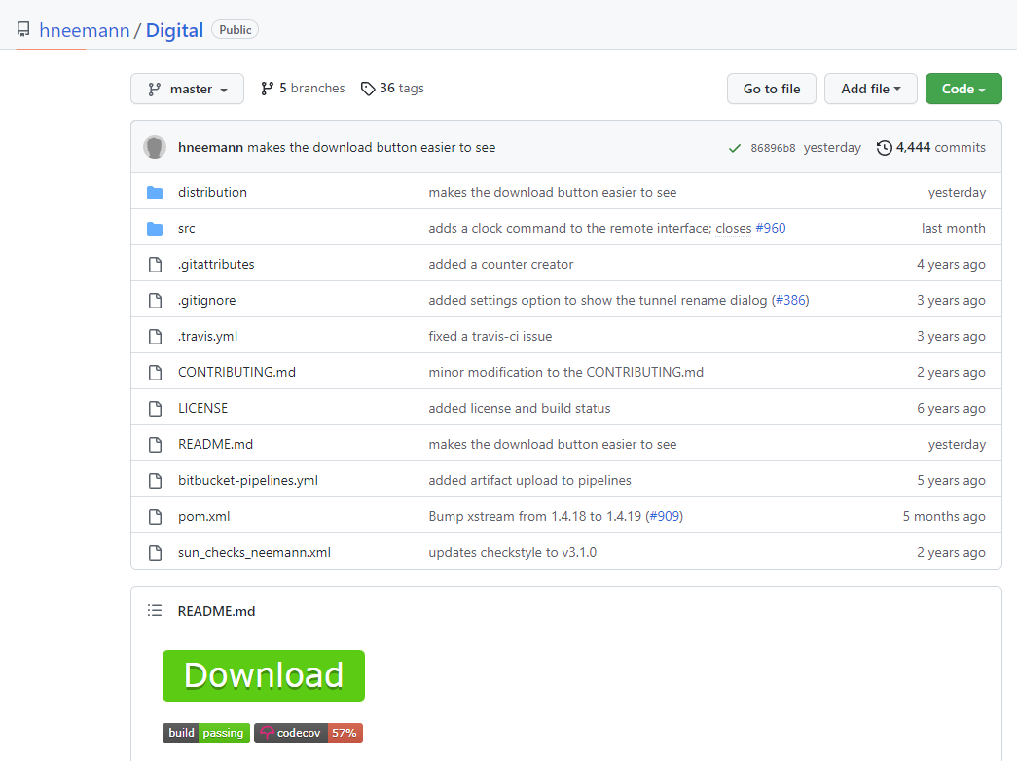
Design App – Digital Circuit Simulator
https://github.com/hneemann/Digital
Create a new subfolder in your $HOME folder called Digital and extract the ZIP file contents into that new subfolder

Slide 42



Launch Digital App
①
①
①

Slide 43

Launch Digital App

Slide 44
Simple Circuit

Slide 45

Pick AND Gate

Slide 46

Drag AND Gate

Slide 47

Place AND Gate
Single LEFT click to place a component

Slide 48
Pick NOT Gate

Slide 49

Drag NOT Gate

Slide 50

Place NOT Gate
Single LEFT click to place a component

Slide 51

Pick OR Gate

Slide 52

Place OR Gate

Slide 53

Place 2nd AND Gate

Slide 54

Place 2nd NOT Gate

Slide 55

Pick Input Signal

Slide 56

Drag Input Signal

Slide 57

Place Input Signal

Slide 58

Place 2nd Input Signal

Slide 59

Place 3rd Input Signal

Slide 60

Place 4th Input Signal

Slide 61

Pick Output Signal

Slide 62

Place Output Signal

Slide 63

Wire Up 1st Input to 1st AND Gate
Single LEFT click
on the output pin of the 1st INPUT

Slide 64

Wire Up 1st Input to 1st AND Gate
Move mouse leftward
(while NOT holding LEFT button)
to the top input pin of the
1st AND Gate

Slide 65

Wire Up 1st Input to 1st AND Gate
Single LEFT click (to end wire drawing mode) and the wire should turn dark blue

Slide 66

Wire Up 1st Input to 1st AND Gate

Slide 67

Wire Up Output of 1st AND to 1st OR Gate

Slide 68

Wire Up Output of 1st AND to 1st OR Gate
Moving mouse DOWN
makes the wire
"turn" the corner

Slide 69

Wire Up Output of 1st AND to 1st OR Gate
Single LEFT click starts a new wire direction

Slide 70

Wire Up Output of 1st AND to 1st OR Gate
Single LEFT click (to end wire drawing mode) and the wire should turn dark blue

Slide 71

Wire Up 3rd Input to 1st NOT to 1st OR Gate

Slide 72

Draw Bounding Rectangle to Select Wire(s)
After selecting the wire press DEL key

Slide 73

Draw Bounding Rectangle to Select Wire(s)
After selecting the wire(s) press DEL key

Slide 74

Wire Up OR Gate to 2nd AND Gate

Slide 75

Wire Up 4th Input to 2nd AND Gate

Slide 76

Wire Up 2nd AND to 2nd NOT Gate

Slide 77

Wire Up 2nd NOT to OUTPUT Signal

Slide 78

Label 1st Input Signal
Right click on Input Symbol

Slide 79

Label 2nd Input Signal
Right click on Input Symbol

Slide 80

Label 3rd and 4th Input Signals

Slide 81

Label Output Signal
Right click on Output Symbol

Slide 82

Label Output Signal

Slide 83

Select Analysis Menu Option

Slide 84

Generate Truth Table for Circuit

Slide 85

Save Circuit File

Slide 86

Save Circuit File

Slide 87

Open Majority Vote Circuit

Slide 88

Open Majority Vote Circuit

Slide 89

Generate Truth Table for Majority Vote Circuit

Slide 90

Generate Truth Table for Majority Vote Circuit

Slide 91



Boolean Logic Gates As Matrices
We can represent the classical bits 0 and 1 as (2 x 1) vectors
We can also represent classical logic gates as matrices
$$False=0=\left[\begin{matrix}1 \\ 0\end{matrix}\right]$$
$$True=1=\left[\begin{matrix}0 \\ 1\end{matrix}\right]$$

Slide 92


Boolean Logic Gates As Matrices
We can apply a NOT gate to bit via matrix multiplication
But the classical AND and OR gates require two inputs
Represented as matrices, the AND gate and OR gate each have a shape 2 x 4 and therefore must act on a vector of shape 4 x 1
The matrix multiplication will produce a 2 x 1, which is a classic bit vector, matching the fact those two gates each have one output line
NOT
0
1
NOT
1
0
2 x 2
2 x 1
2 x 1

Slide 93

Tensor Products
$$\left[\begin{matrix}2 \\ 3\end{matrix}\right]⊗\left[\begin{matrix}4 \\ 6 \\ 3\end{matrix}\right]=\left[\begin{matrix}2∗4 \\ 2∗6 \\ 2∗3 \\ 3∗4 \\ 3∗6 \\ 3∗3\end{matrix}\right]=\left[\begin{matrix}8 \\ 12 \\ 6 \\ 12 \\ 18 \\ 9\end{matrix}\right]$$

Slide 94
Tensor Products
There are no values for $x,y,a,b,c$ that will produce the required vector
$$\left[\begin{matrix}2 \\ 3\end{matrix}\right]⊗\left[\begin{matrix}4 \\ 6 \\ 3\end{matrix}\right]=\left[\begin{matrix}2∗4 \\ 2∗6 \\ 2∗3 \\ 3∗4 \\ 3∗6 \\ 3∗9\end{matrix}\right]=\left[\begin{matrix}8 \\ 12 \\ 6 \\ 12 \\ 18 \\ 9\end{matrix}\right]$$
$$\left[\begin{matrix}8 \\ 0 \\ 0 \\ 0 \\ 0 \\ 18\end{matrix}\right]=\left[\begin{matrix}x \\ y\end{matrix}\right]⊗\left[\begin{matrix}a \\ b \\ c\end{matrix}\right]=\left[\begin{matrix}x∗a \\ x∗b \\ x∗c \\ y∗a \\ y∗b \\ y∗c\end{matrix}\right]=?$$
A vector than can be written as the tensor of two vectors is called separable
A vector than cannot be written as the tensor of two vectors is called entangled

Slide 95



Tensor Products
2 x 2
3 x 3

Slide 96

Tensor Products
2 x 2
3 x 3
6 x 6

Slide 97




Tensor Products
0
0
$$\left(0\right)$$
$$\left[\begin{matrix}1 \\ 0\end{matrix}\right]⊗\left[\begin{matrix}1 \\ 0\end{matrix}\right]=\left[\begin{matrix}1∗1 \\ 1∗0 \\ 0∗1 \\ 0∗0\end{matrix}\right]=\left[\begin{matrix}1 \\ 0 \\ 0 \\ 0\end{matrix}\right]$$
A = 0, B = 0
$${00}_{2}=0_{10}$$
$$A=\left[\begin{matrix}a_{0} \\ a_{1}\end{matrix}\right]$$
$$B=\left[\begin{matrix}b_{0} \\ b_{1}\end{matrix}\right]$$
0
1
$$\left[\begin{matrix}1 \\ 0\end{matrix}\right]⊗\left[\begin{matrix}0 \\ 1\end{matrix}\right]=\left[\begin{matrix}1∗0 \\ 1∗1 \\ 0∗0 \\ 0∗1\end{matrix}\right]=\left[\begin{matrix}0 \\ 1 \\ 0 \\ 0\end{matrix}\right]$$
$$A⊗B=\left[\begin{matrix}a_{0}∗b_{0} \\ a_{0}∗b_{1} \\ a_{1}∗b_{0} \\ a_{1}∗b_{1}\end{matrix}\right]$$
$$\left(1\right)$$
A = 0, B = 1
$${01}_{2}=1_{10}$$
1
0
$$\left[\begin{matrix}0 \\ 1\end{matrix}\right]⊗\left[\begin{matrix}1 \\ 0\end{matrix}\right]=\left[\begin{matrix}0∗1 \\ 0∗0 \\ 1∗1 \\ 1∗0\end{matrix}\right]=\left[\begin{matrix}0 \\ 0 \\ 1 \\ 0\end{matrix}\right]$$
A = 1, B = 0
$${10}_{2}=2_{10}$$
We can encode the state of two classical bits into one vector using the tensor product $A⊗B$
$$\left(2\right)$$
1
1
$$\left[\begin{matrix}0 \\ 1\end{matrix}\right]⊗\left[\begin{matrix}0 \\ 1\end{matrix}\right]=\left[\begin{matrix}0∗0 \\ 0∗1 \\ 1∗0 \\ 1∗1\end{matrix}\right]=\left[\begin{matrix}0 \\ 0 \\ 0 \\ 1\end{matrix}\right]$$
A = 1, B = 1
$${11}_{2}=3_{10}$$
$$\left(3\right)$$

Slide 98
Boolean Logic Gates As Matrices
We can now apply the AND gate using two encoded input bits and calculate a single output bit
$$AND=\left[\begin{matrix}1 & 1 & 1 & 0 \\ 0 & 0 & 0 & 1\end{matrix}\right]$$
1
0
$$\left[\begin{matrix}0 \\ 1\end{matrix}\right]⊗\left[\begin{matrix}1 \\ 0\end{matrix}\right]=\left[\begin{matrix}0∗1 \\ 0∗0 \\ 1∗1 \\ 1∗0\end{matrix}\right]=\left[\begin{matrix}0 \\ 0 \\ 1 \\ 0\end{matrix}\right]$$
A = 1, B = 0
T
F
AND
(T, F)
$$\left[\begin{matrix}1 & 1 & 1 & 0 \\ 0 & 0 & 0 & 1\end{matrix}\right]\left[\begin{matrix}0 \\ 0 \\ 1 \\ 0\end{matrix}\right]=\left[\begin{matrix}1∗0+1∗0+1∗1+0∗0 \\ 0∗0+0∗0+0∗1+1∗0\end{matrix}\right]=\left[\begin{matrix}1 \\ 0\end{matrix}\right]=0=False$$

Slide 99
Boolean Logic Gates As Matrices
We can now apply the AND gate using two encoded input bits and calculate a single output bit
$$AND=\left[\begin{matrix}1 & 1 & 1 & 0 \\ 0 & 0 & 0 & 1\end{matrix}\right]$$
1
1
$$\left[\begin{matrix}0 \\ 1\end{matrix}\right]⊗\left[\begin{matrix}0 \\ 1\end{matrix}\right]=\left[\begin{matrix}0∗0 \\ 0∗1 \\ 1∗0 \\ 1∗1\end{matrix}\right]=\left[\begin{matrix}0 \\ 0 \\ 0 \\ 1\end{matrix}\right]$$
A = 1, B = 1
T
T
AND
(T, T)
$$\left[\begin{matrix}1 & 1 & 1 & 0 \\ 0 & 0 & 0 & 1\end{matrix}\right]\left[\begin{matrix}0 \\ 0 \\ 0 \\ 1\end{matrix}\right]=\left[\begin{matrix}1∗0+1∗0+1∗0+0∗1 \\ 0∗0+0∗0+0∗0+1∗1\end{matrix}\right]=\left[\begin{matrix}0 \\ 1\end{matrix}\right]=1=True$$

Slide 100
Boolean Logic Gates As Matrices
We can now apply the OR gate using two encoded input bits and calculate a single output bit
$$OR=\left[\begin{matrix}1 & 0 & 0 & 0 \\ 0 & 1 & 1 & 1\end{matrix}\right]$$
0
0
$$\left[\begin{matrix}1 \\ 0\end{matrix}\right]⊗\left[\begin{matrix}1 \\ 0\end{matrix}\right]=\left[\begin{matrix}1∗1 \\ 1∗0 \\ 0∗1 \\ 0∗0\end{matrix}\right]=\left[\begin{matrix}1 \\ 0 \\ 0 \\ 0\end{matrix}\right]$$
A = 0, B = 0
F
F
OR
(F, F)
$$\left[\begin{matrix}1 & 0 & 0 & 0 \\ 0 & 1 & 1 & 1\end{matrix}\right]\left[\begin{matrix}1 \\ 0 \\ 0 \\ 0\end{matrix}\right]=\left[\begin{matrix}1∗1+0∗0+0∗0+0∗0 \\ 0∗1+1∗0+1∗0+1∗0\end{matrix}\right]=\left[\begin{matrix}1 \\ 0\end{matrix}\right]=0=False$$

Slide 101
Boolean Logic Gates As Matrices
We can now apply the OR gate using two encoded input bits and calculate a single output bit
$$OR=\left[\begin{matrix}1 & 0 & 0 & 0 \\ 0 & 1 & 1 & 1\end{matrix}\right]$$
1
0
$$\left[\begin{matrix}0 \\ 1\end{matrix}\right]⊗\left[\begin{matrix}1 \\ 0\end{matrix}\right]=\left[\begin{matrix}0∗1 \\ 0∗0 \\ 1∗1 \\ 1∗0\end{matrix}\right]=\left[\begin{matrix}0 \\ 0 \\ 1 \\ 0\end{matrix}\right]$$
A = 1, B = 0
T
F
OR
(T, F)
$$\left[\begin{matrix}1 & 0 & 0 & 0 \\ 0 & 1 & 1 & 1\end{matrix}\right]\left[\begin{matrix}0 \\ 0 \\ 1 \\ 0\end{matrix}\right]=\left[\begin{matrix}1∗0+0∗0+0∗1+0∗0 \\ 0∗0+1∗0+1∗1+1∗0\end{matrix}\right]=\left[\begin{matrix}0 \\ 1\end{matrix}\right]=1=True$$

Slide 102


Boolean Logic Gates As Matrices
We can also combine gates via matrix multiplication, and produce a universal gate like NAND
2 x 2
2 x 4
2 x 4

Slide 103


Run Cell 1 – gate_matrices.ipynb
①
②
③
④
⑤
0
1
0
1

Slide 104



Run Cell 2 – gate_matrices.ipynb
①
②
③
④
⑤
⑥

Slide 105








Run Cell 3 – gate_matrices.ipynb
①
②
Leopold Kronecker
(1823-1891)
③
a b
0 0
0 1
1 0
1 1
a b
0 0
0 1
1 0
1 1
We can encode the state of two classical bits into one vector using the tensor product $A⊗B$
a b
0 0
0 1
1 0
1 1
a b
0 0
0 1
1 0
1 1

Slide 106



Run Cell 4 – gate_matrices.ipynb
①
②
③
Represented as a matrix, the AND gate has a shape 2 x 4 and therefore must act on a vector of shape 4 x 1
The matrix multiplication will produce a 2 x 1, which is a classic bit vector, matching the fact the AND gate has one output line

Slide 107



Run Cell 5 – gate_matrices.ipynb
①
②
③
Represented as a matrix, the OR gate has a shape 2 x 4 and therefore must act on a vector of shape 4 x 1
The matrix multiplication will produce a 2 x 1, which is a classic bit vector, matching the fact the OR gate has one output line

Slide 108




Run Cell 6 – gate_matrices.ipynb
①
②
Note: We multiply the gate matrices in reverse order than they appear in the circuit diagram
③

Slide 109
Simulating a Simple Circuit Using Matrices
We can now simulate more complex circuits using tensor products to "link" multiple input lines and matrix multiplication to represent the action of Boolean gates on those input states

Slide 110


Run Cell 1 – simple_circuit.ipynb
①
②
③
④
⑤
⑥
⑦
⑧

Slide 111

Run Cell 2 – simple_circuit.ipynb
①
②
③
④
⑤
⑥
⑦
g1
g3
g2
g4
g5

Slide 112

Run Cell 3 – simple_circuit.ipynb
①
②
③
④
⑤
⑥

Slide 113


Run Cell 3 – simple_circuit.ipynb

Slide 114
Session 21 – Know You Know…
Digital Logic Circuits
All computers are made from chains of simple logic gates
NAND and NOR gates are universal → they can make all other classical Boolean logic gates!
How a computer performs arithmetic = full adders
Subtraction is just addition with inverted logic
Multiplication is just repeated addition
Division is just repeated subtraction
How a computer stores numbers in memory = flip-flops
Four gates make a bit, eight bits make up a byte
Imagine how many gates are in your 128GB smartphone!

Slide 115
Session 21 – Know You Know…
The tensor (Kronecker) products combine individual classical bits into a separable state vector
A two-bit system can be represented by a 4 x 1 state vector
A two-bit zero state is not [0,0,0,0] but rather [1,0,0,0]
You must think in terms of index numbers, not element values
Zero is a thing, zero counts = the first element is at index zero
Therefore, a zero is [1,0,0,0] because it has a 1 in the first element
We can represent Boolean logic gates as 2 x 4 matrices
We apply logic operators to state vectors using matrix multiplication – we "dot" the gate matrix into the input state vector
We can compose gates by dotting each gate’s action operator

Slide 116
Task 21-01
Create a Jupyter Lab Notebook called octal_converter.ipynb
In cell 1, convert the octal number 2323 to base 10 (decimal) by looping, and display both numbers
In cell 2, convert the decimal number you calculated in cell 1 back to octal by looping, and display both numbers
In cell 3, convert the octal number 2323 to base 10 (decimal) without looping, and display both numbers
In cell 4, convert the decimal number you calculated in cell 3 back to octal without looping, and display both numbers
Upload your solution to the BNL QIS101 SharePoint site

Slide 117
Task 21-02
Using the Digital App, create a circuit file called full_adder.dig
Using only 1 OR, 2 AND, 2 XOR gates, plus five I/O pins, design a FULL ADDER circuit
The circuit has 3 input lines, and 2 output lines to indicate the sum and if there needs to be a carry to the next column
Verify your circuit by having Digital create a truth table
Upload to the BNL QIS101 SharePoint site your circuit (.dig) file

Slide 118
Task 21-03
Create a Jupyter Lab Notebook called majority_vote.ipynb to simulate the circuit and generate the truth table of the majority vote circuit shown on slide #24
In Cell 1, declare all the necessary arrays for the Boolean states and logic gates required to simulate all permutations of input and output states
In Cell 2, implement the complete classical digital logic circuit using Numpy matrix algebra functions
In Cell 3, generate and display the full truth table for the circuit
Upload your solution to the BNL QIS101 SharePoint site

